Slide 1

Data Visualization, 1e
Chapter 2: Selecting a Chart Type

Slide 2
Chapter Objectives
After completing this chapter, you will be able to:
LO 2.1 Create charts and graphs using Excel
LO 2.2 Edit charts and graphs created using Excel
LO 2.3 Select an appropriate chart type for a given goal and data type
LO 2.4 Glean insights from charts and graphs
LO 2.5 Describe which chart types should be avoided and why

Slide 3
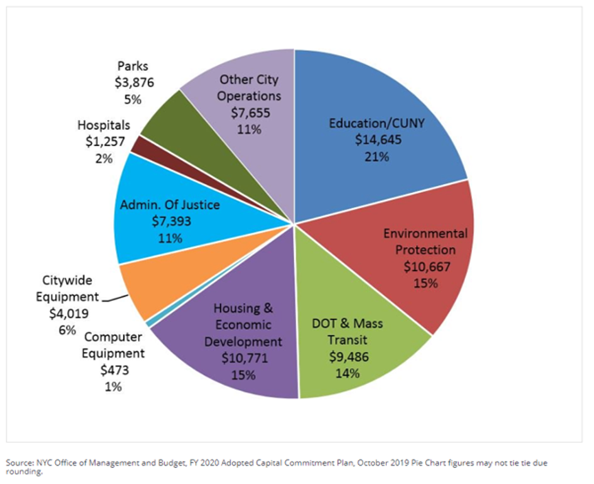
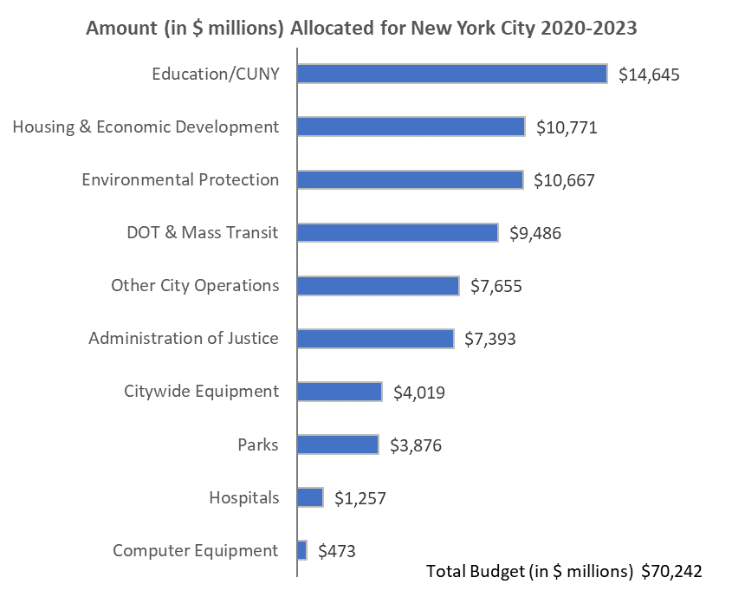
Data Visualization Makeover
A pie chart showing the NYC budget allocation
A bar chart showing the NYC budget allocation
*See additional comments in the notes.
Notes:
See discussion activity #1 for further details.

Slide 4
2.1 Selecting an Appropriate Chart
Some of the common goals for charts are to show the following:
The composition – the breakdown of a whole entity into its components.
The ranking – is the ordering of items in order of contextual importance.
The relationship – is the identification of patterns existing between pairs of variables.
The distribution – is the dispersion of components of a whole entity.

Slide 5
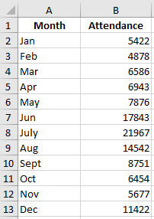
2.2 Creating a Chart in Excel
The following steps show how to create a column chart in Excel using the data in the file Zoo.
Step 1. Select cells A1:B13
Step 2. Click the Insert tab on the Ribbon
Step 3. Click the Insert Column or Bar Chart button in the Charts group
Step 4. When the list of column and bar charts subtypes appears, click the Clustered Column button
In Excel, the horizontal axis on the chart generally represents the leftmost column of data.
The assignment of data to the horizontal and vertical axes can be switched by right-clicking on the chart, choosing Select Data Source, and on the Select Data Source dialog box, click on Switch Row/Column.
To create a chart using nonadjacent columns of data in Excel, select the leftmost column you wish to include in the chart, press and hold down the control key (Ctrl), select the other columns of data you want to include.

Slide 6
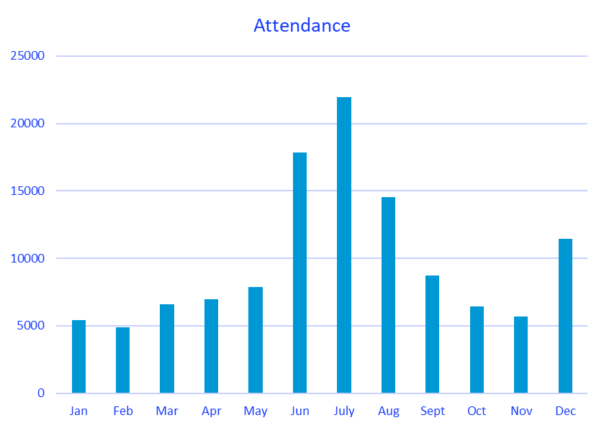
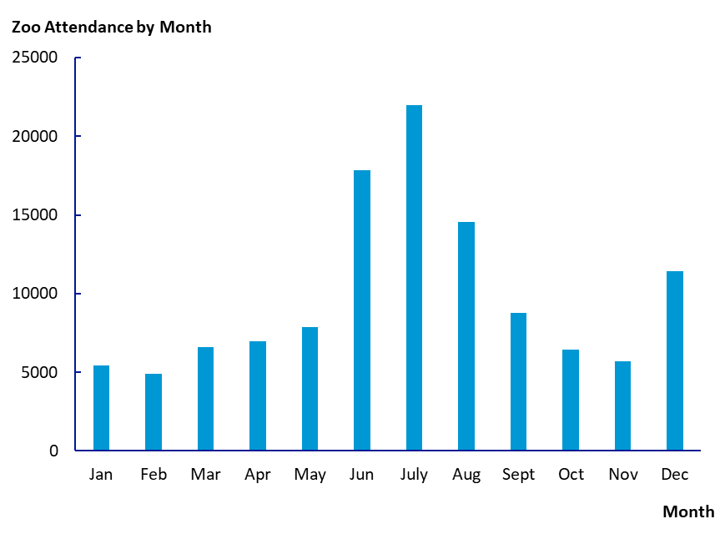
2.2 Editing a Chart in Excel
Step-by-step instructions on how to improve the chart shown to the left so that it appears as shown to the right are shown in the notes.
Notes:
Remove horizontal grid lines and edit the title:
Step 1: Click anywhere on the chart
Click the Chart Elements button
Deselect the check box for Gridlines
Step 2: Click the Chart Title text box above the chart and replace “Chart Title” with Zoo Attendance by Month
Inside the text box, highlight “Zoo Attendance by Month”
The Chart Elements button offers a variety of features, in addition to deleting or adding gridlines. These include, among others, the ability to add or delete axes and axis titles, a chart title, data labels, gridlines, a legend and add a trendline.
The Chart Elements button is not available for Excel for Mac. To access the features of Chart Elements in Excel for Mac, double click on the chart, click the Chart Design tab, and click Add Chart Element from the Chart Layouts group.
Format the horizontal axis and axis labels:
Step 3. Double click on any label of the horizontal axis
Step 4. When the Format Axis task pane appears, click the Fill & Line button
Click Line
Select Solid line
In the drop down to the right of Color, under Theme Colors, select Black
Step 5. Click the Home tab on the Ribbon and in the Font group select Calibri 10.5
When adding axis titles, the horizontal axis title is placed in the center of the axis. To move the axis title to the right, click on the border of the axis title box and slide the text box to the right.
When adding axis titles, the vertical axis title will appear midway up the vertical axis and the text will be vertically aligned. Right-click on the axis title and select Format Axis Title.
When the Format Axis Title task pane appears, click on the Size & Properties button select Horizontal from the drop-down menu next to Text Direction. Click on the border of the axis title box and slide the text box up to the top of the axis.
Format the vertical axis and axis labels:
Step 6. Double click on any label of the vertical axis
Step 7. When the Format Axis task pane appears, click the Fill & Line button
Click Line
Select Solid line
In the drop down to the right of Color, under Theme Colors, select Black
Step 8. In the Format Axis task pane, click the Axis Options button
Click Tick Marks
Next to Major type, select Inside
Step 9. Click the Home tab on the Ribbon and in the Font group select Calibri 10.5
Eliminate the border of the chart:
Step 10. Click on the Chart Area of the chart (anywhere outside of the rectangular area delimited by the horizontal and vertical axes of the chart)
Step 11. In the Format Chart Area task pane, click Chart Options
Click the Fill & Line button
Click Border
Click No line
The Chart Styles button allows you to change the style of the chart type you have selected, as well the color scheme of the chart. The Chart Styles button is not available for Excel for Mac.
To access the features of Chart Styles in Excel for Mac, double click on the chart, click the Chart Design tab, and click on a style from the Chart Styles group. To change the color scheme, click the Change Colors button in the Chart Styles group.

Slide 7
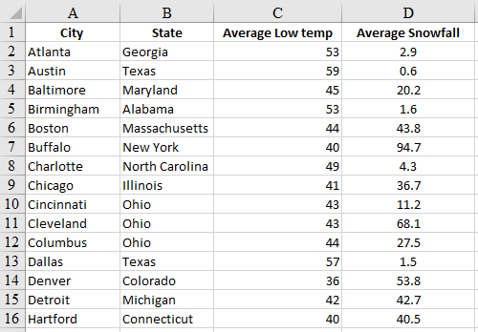
2.3 Build a Scatter Chart
The following steps show how to create a scatter chart in Excel using the data in the file Snow.
Step 1. Select cells C1:D52
Step 2. Click the Insert tab on the Ribbon
Step 3. Click the Insert Scatter (X,Y) or Bubble Chart button in the Charts group
Step 4. When the list chart subtypes appear, click the Scatter button. Then edit the chart as outlined in Section 2.2.

Slide 8
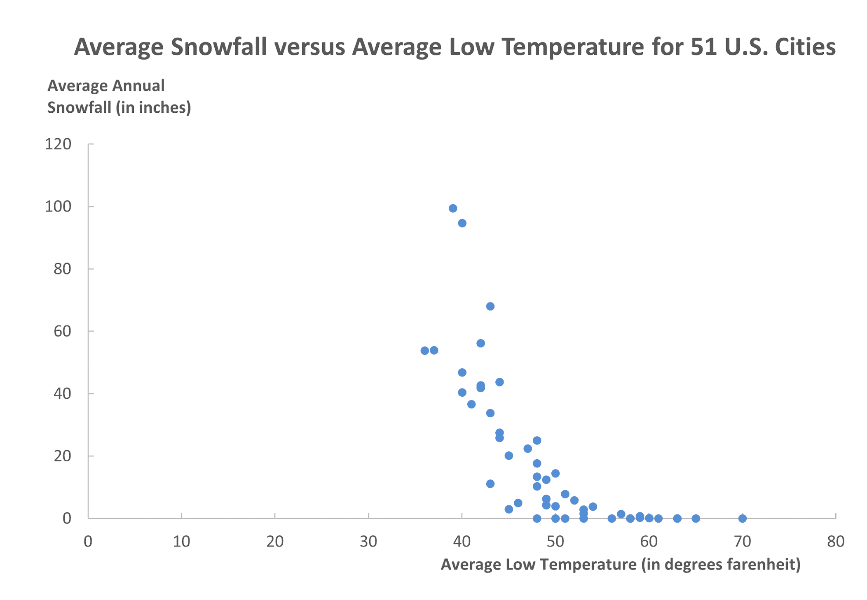
2.3 Interpret a Scatter Chart
Each point on the chart represents a pair of measurements for 51 U.S. cities.
The measurements are average low temperature (in degrees Fahrenheit) and the average annual amount of snowfall (inches).
The chart shows how the average annual amount of snowfall intuitively levels off at zero for warm-weather cities.
Scatter charts are among the most useful charts for exploring pairs of quantitative data.

Slide 9
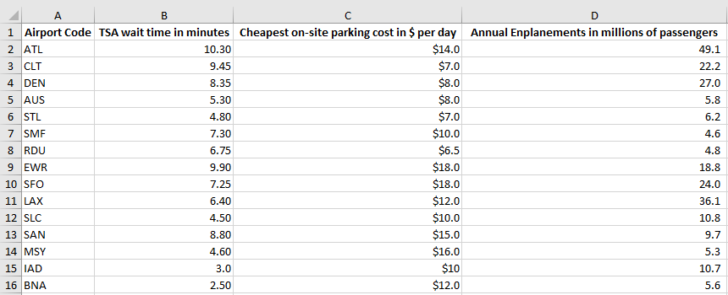
2.3 Build a Bubble Chart
The following steps show how to create a bubble chart in Excel using the data in the file AirportData.
Step 1. Select cells B1:D16
Step 2. Click the Insert tab on the Ribbon
Step 3. Click the Insert Scatter (X,Y) or Bubble Chart button in the Charts group
Step 4. When the list chart subtypes appear, click the Bubble button. Then, edit the chart as outlined in Section 2.2.

Slide 10
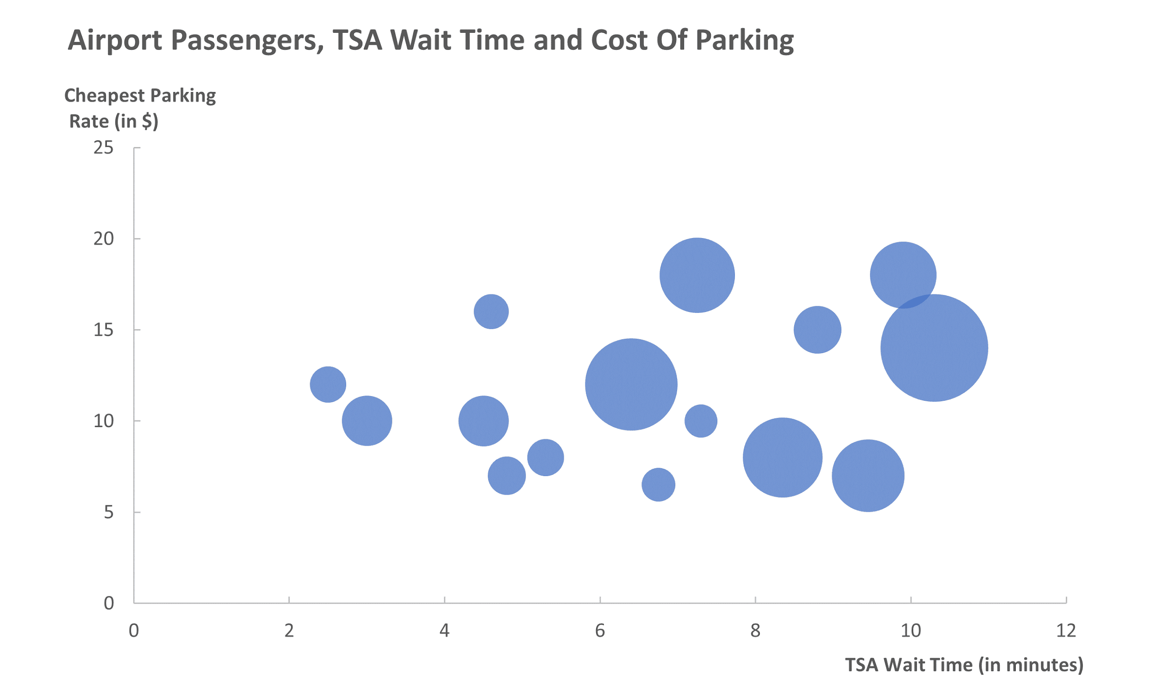
2.3 Interpret a Bubble Chart
A bubble chart allows us to introduce a third quantitative variable, displayed by using different sized dots, which we refer to as bubbles.
For each of the 15 airports, we have the following quantitative variables:
Horizontal axis: Average wait time [in minutes] in the non-priority TSA queue.
Vertical axis: The cheapest on-site daily rate [in $] for parking at the airport.
Bubble size: The number of enplanements [in millions of passengers] in a year, including transfers.

Slide 11
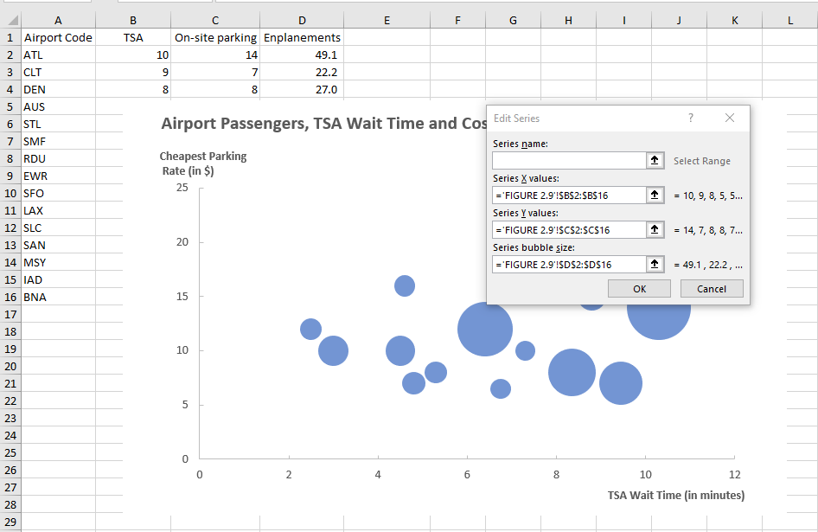
2.3 Edit a Bubble Chart
You can use the following steps to change the variable assignments to the x-axis, y-axis, and bubbles:
Step 1. Right-click on any bubble
Step 2. Click on Select Data…
Step 3. When the Select Data Source dialog box appears, click the Edit button under Legend Entries (Series)
Step 4. Enter the location of the data you want to correspond to the horizontal values in the Series X values: box. Note: do not include column headers.
Step 5. Repeat Step 4 for the Series Y Values: box and Series bubble size: box and click OK

Slide 12
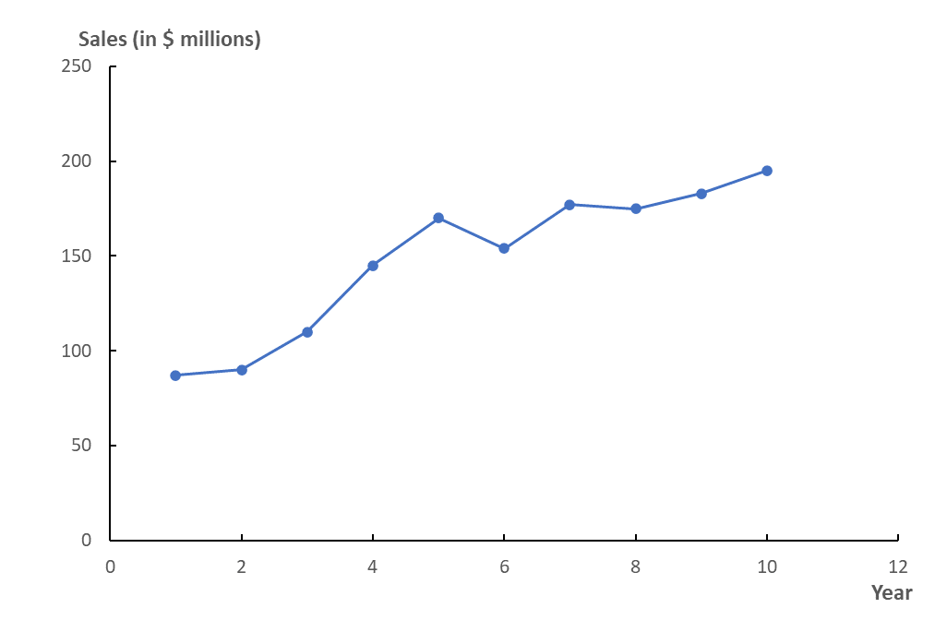
2.4 Line Charts
A line chart is like scatter chart with a line connecting the points.
Line charts are handy for time series data because the addition of lines connecting the points suggests continuity and makes it easier for the viewer to see and interpret changes over time.

Slide 13
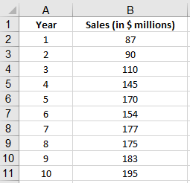
2.4 Build a line Chart
The following steps show how to create a line chart in Excel using the data in the file Cheetah.
Step 1. Select cells A1:B11
Step 2. Click the Insert tab on the Ribbon
Step 3. Click the Insert Scatter (X,Y) or Bubble Chart button in the Charts group
Step 4. Select Scatter with Straight Lines and Markers. Then edit the chart as described in Section 2.2

Slide 14
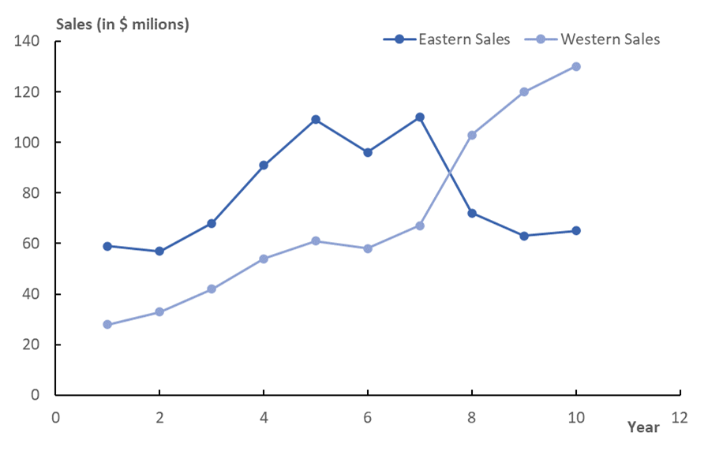
2.4 Multiple-Line Charts
Sales in the western region have increased over the last three of the given ten-year period.
In contrast, sales in the eastern region have dropped significantly since year seven.

Slide 15
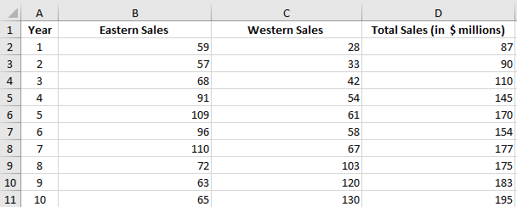
2.4 Build a Multiple-Line Chart
The following steps show how to create a multiple-line chart in Excel using the data in the file CheetahRegion.
Step 1. Select cells A1:C11 (do not select cells D1:D11)
Step 2. Repeat Steps 2-4 shown before to create a line chart.
Step 3. Select Chart Style. Click the Color tab and select the Monochromatic Palette 1 option.

Slide 16
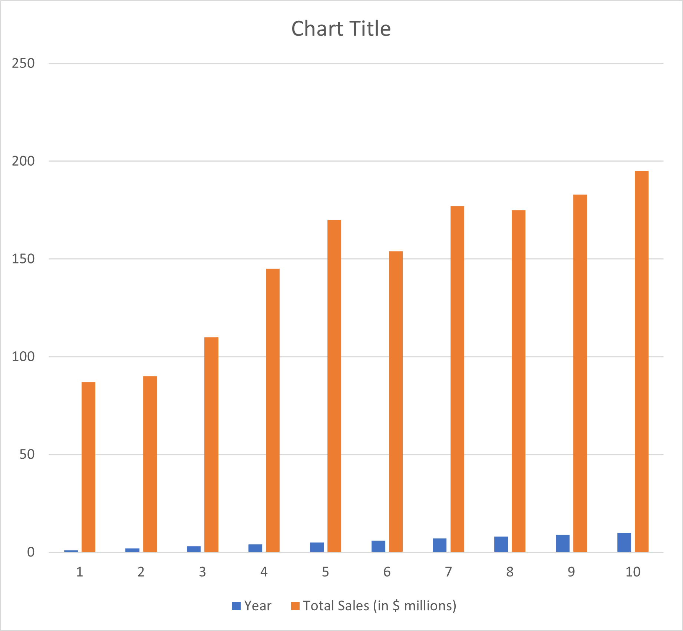
2.4 Column Charts
The following steps create the column chart of the Cheetah Sports sales data used before building a column chart.
Step 1. Select cells A1:B11
Step 2. Click the Insert tab on the Ribbon.
Step 3. In the Charts group, click the Insert Column or Bar Chart button
Step 4. Select Clustered Column
As you can see, the chart is incorrectly rendered because Excel displays the year as if it were a quantitative variable.
We need to correct the chart as shown in the following slide.

Slide 17
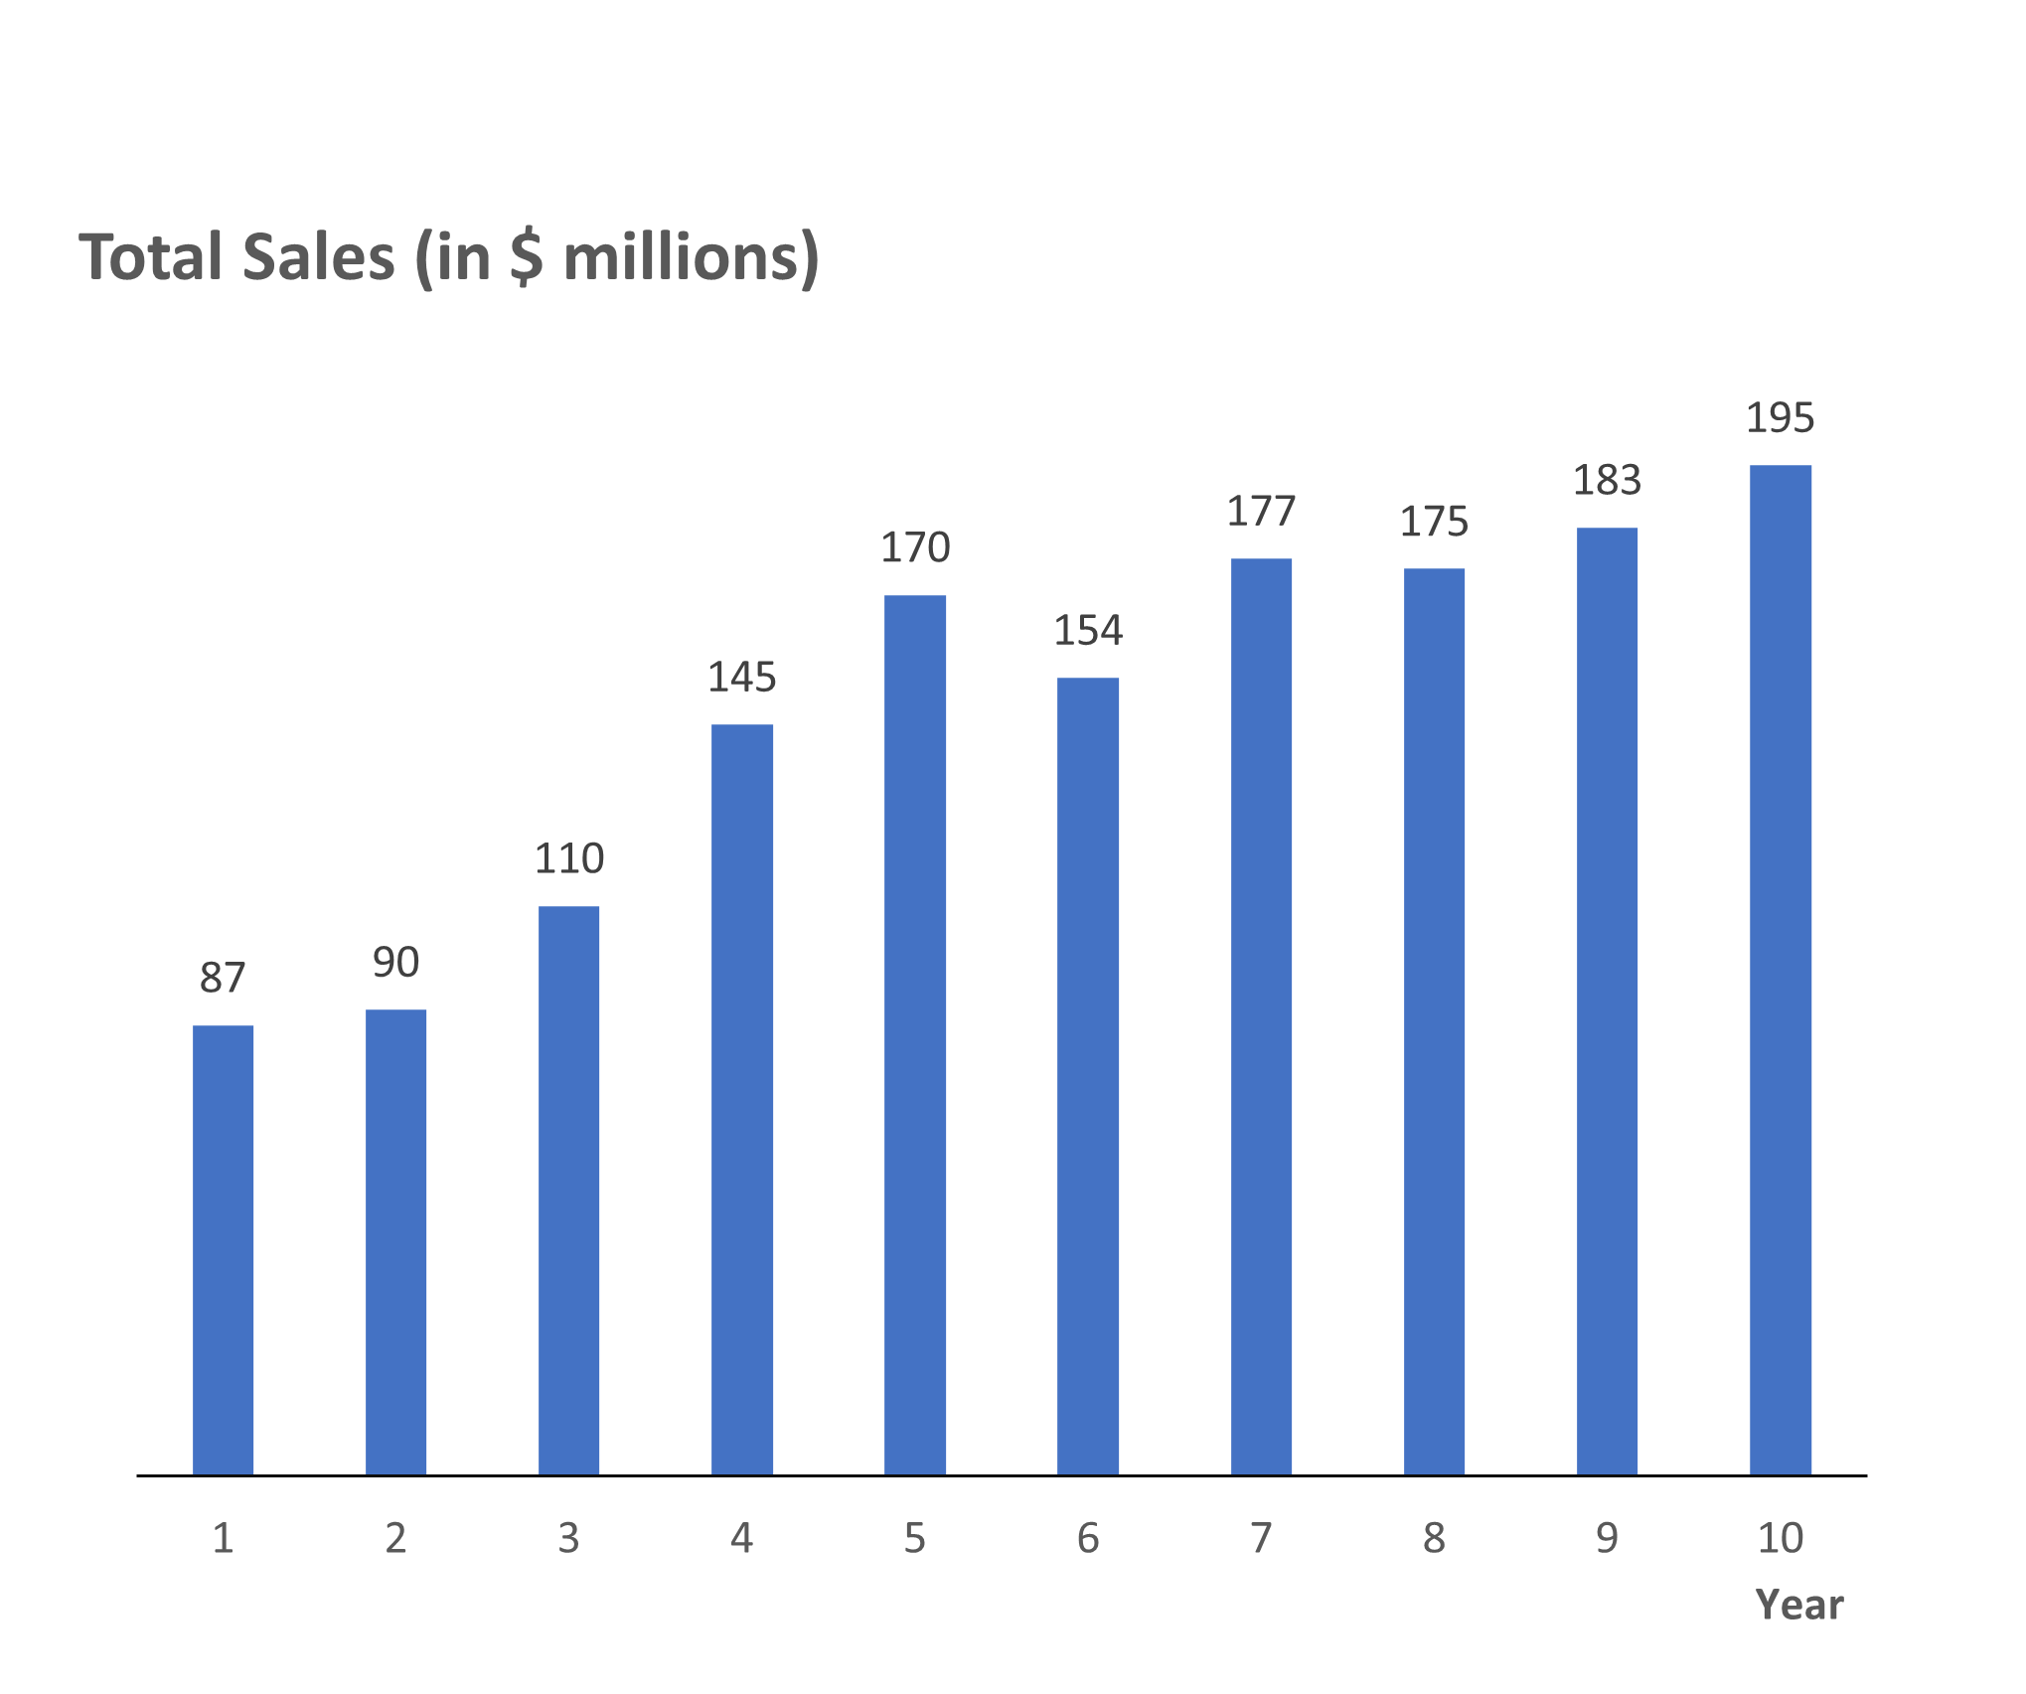
2.4 Edit a Column Chart
To fix the chart so that it displays the correct number of quantitative variables – in this case, one – we need to follow these additional steps:
Step 5. Right-click on the chart and select Change Chart Type…
Step 6. When the Change Chart Type task pane opens, select the Cluster Column type that plots the single variable Sales with ten monochromatic columns, and click OK
Then edit the chart as outlined in Section 2.2.
The next step adds data labels to the bars:
Step 7. Click on the Chart Elements button and select Data Labels.
*See additional comments in the notes.
Notes:
A line chart is preferable when the audience needs to see how the sales are changing.
With its labels, a column chart is preferable when the audience needs to know the sales values for each year.
A line chart is also preferable to a column chart with data labels when there are numerous categories or time periods. The data labels would appear too cluttered and unreadable.

Slide 18
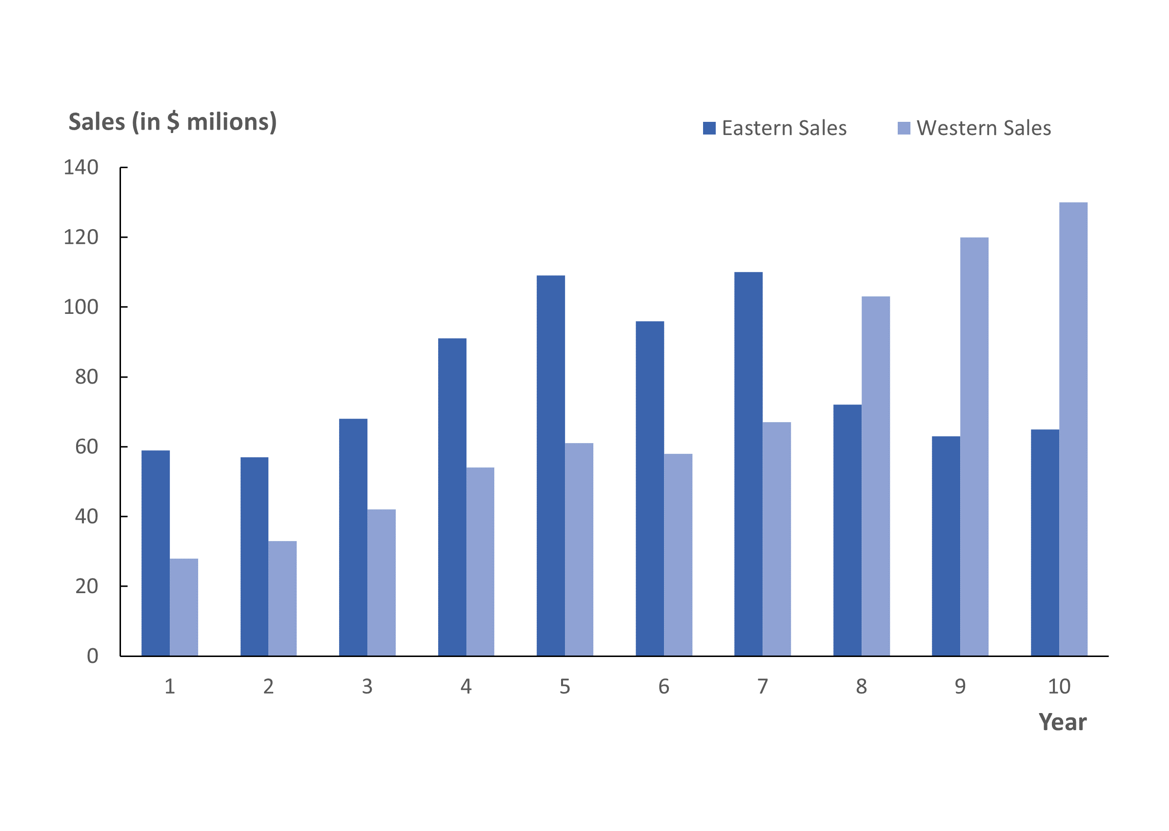
2.4 Clustered Column Charts
The following steps create the clustered column chart of the CheetahRegion sports sales data previously used for a multiple line chart.
Step 1. Select cells A1:C11 (do not select cells D1:D11)
Step 2. Follow Steps 2-6 previously outlined for a column chart, including the change of color scheme to Monochromatic Palette 1 (using the Chart Styles option)
The multiple line chart option is less cluttered than the clustered column chart shown here.
The best option to convey how total sales are changing is the stacked column chart.

Slide 19
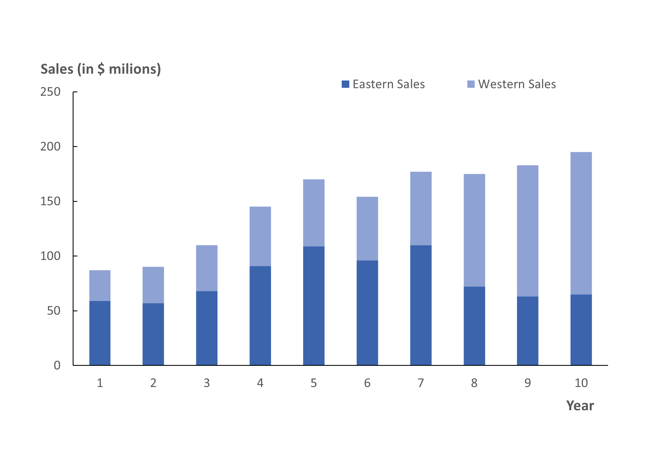
2.4 Stacked Column Charts
The following steps create the stacked column chart of the CheetahRegion sports sales data previously used to build a clustered column chart.
Step 1. Select cells A1:C11 (do not select cells D1:D11)
Step 2. Follow Steps 2-6 previously outlined for a column chart, except that in Step 4 we click on the Insert Column or Bar Chart in the Charts group and select Stacked Column
This chart shows the combination of eastern and western sales by year and the total height of the column indicates total sales.
*See additional comments in the notes.
Notes:
The Cheetah Sports example with regional data demonstrates the important principle that the appropriate chart depends not only on the type of data but also on the goal of the analysis.
If demonstrating the change in sales over time within each region is a key point, then a line chart would be a better choice.
If representing the total sales level and how each region contributes to total sales over time is important, then a stacked column chart is the best choice.

Slide 20
2.4 Bar Charts
All column charts, clustered and stacked alike, can also be represented horizontally as bar charts.
A bar chart may be preferable over the corresponding column chart when there are lengthy category names that are easier to display horizontally.
For time series data, a column chart provides for a more natural display of the passage of time horizontally, from left to right.
To build a bar chart, follow the same steps used for a column chart earlier in this section, but on step 4 select Clustered Bar or Stacked Bar instead.

Slide 21
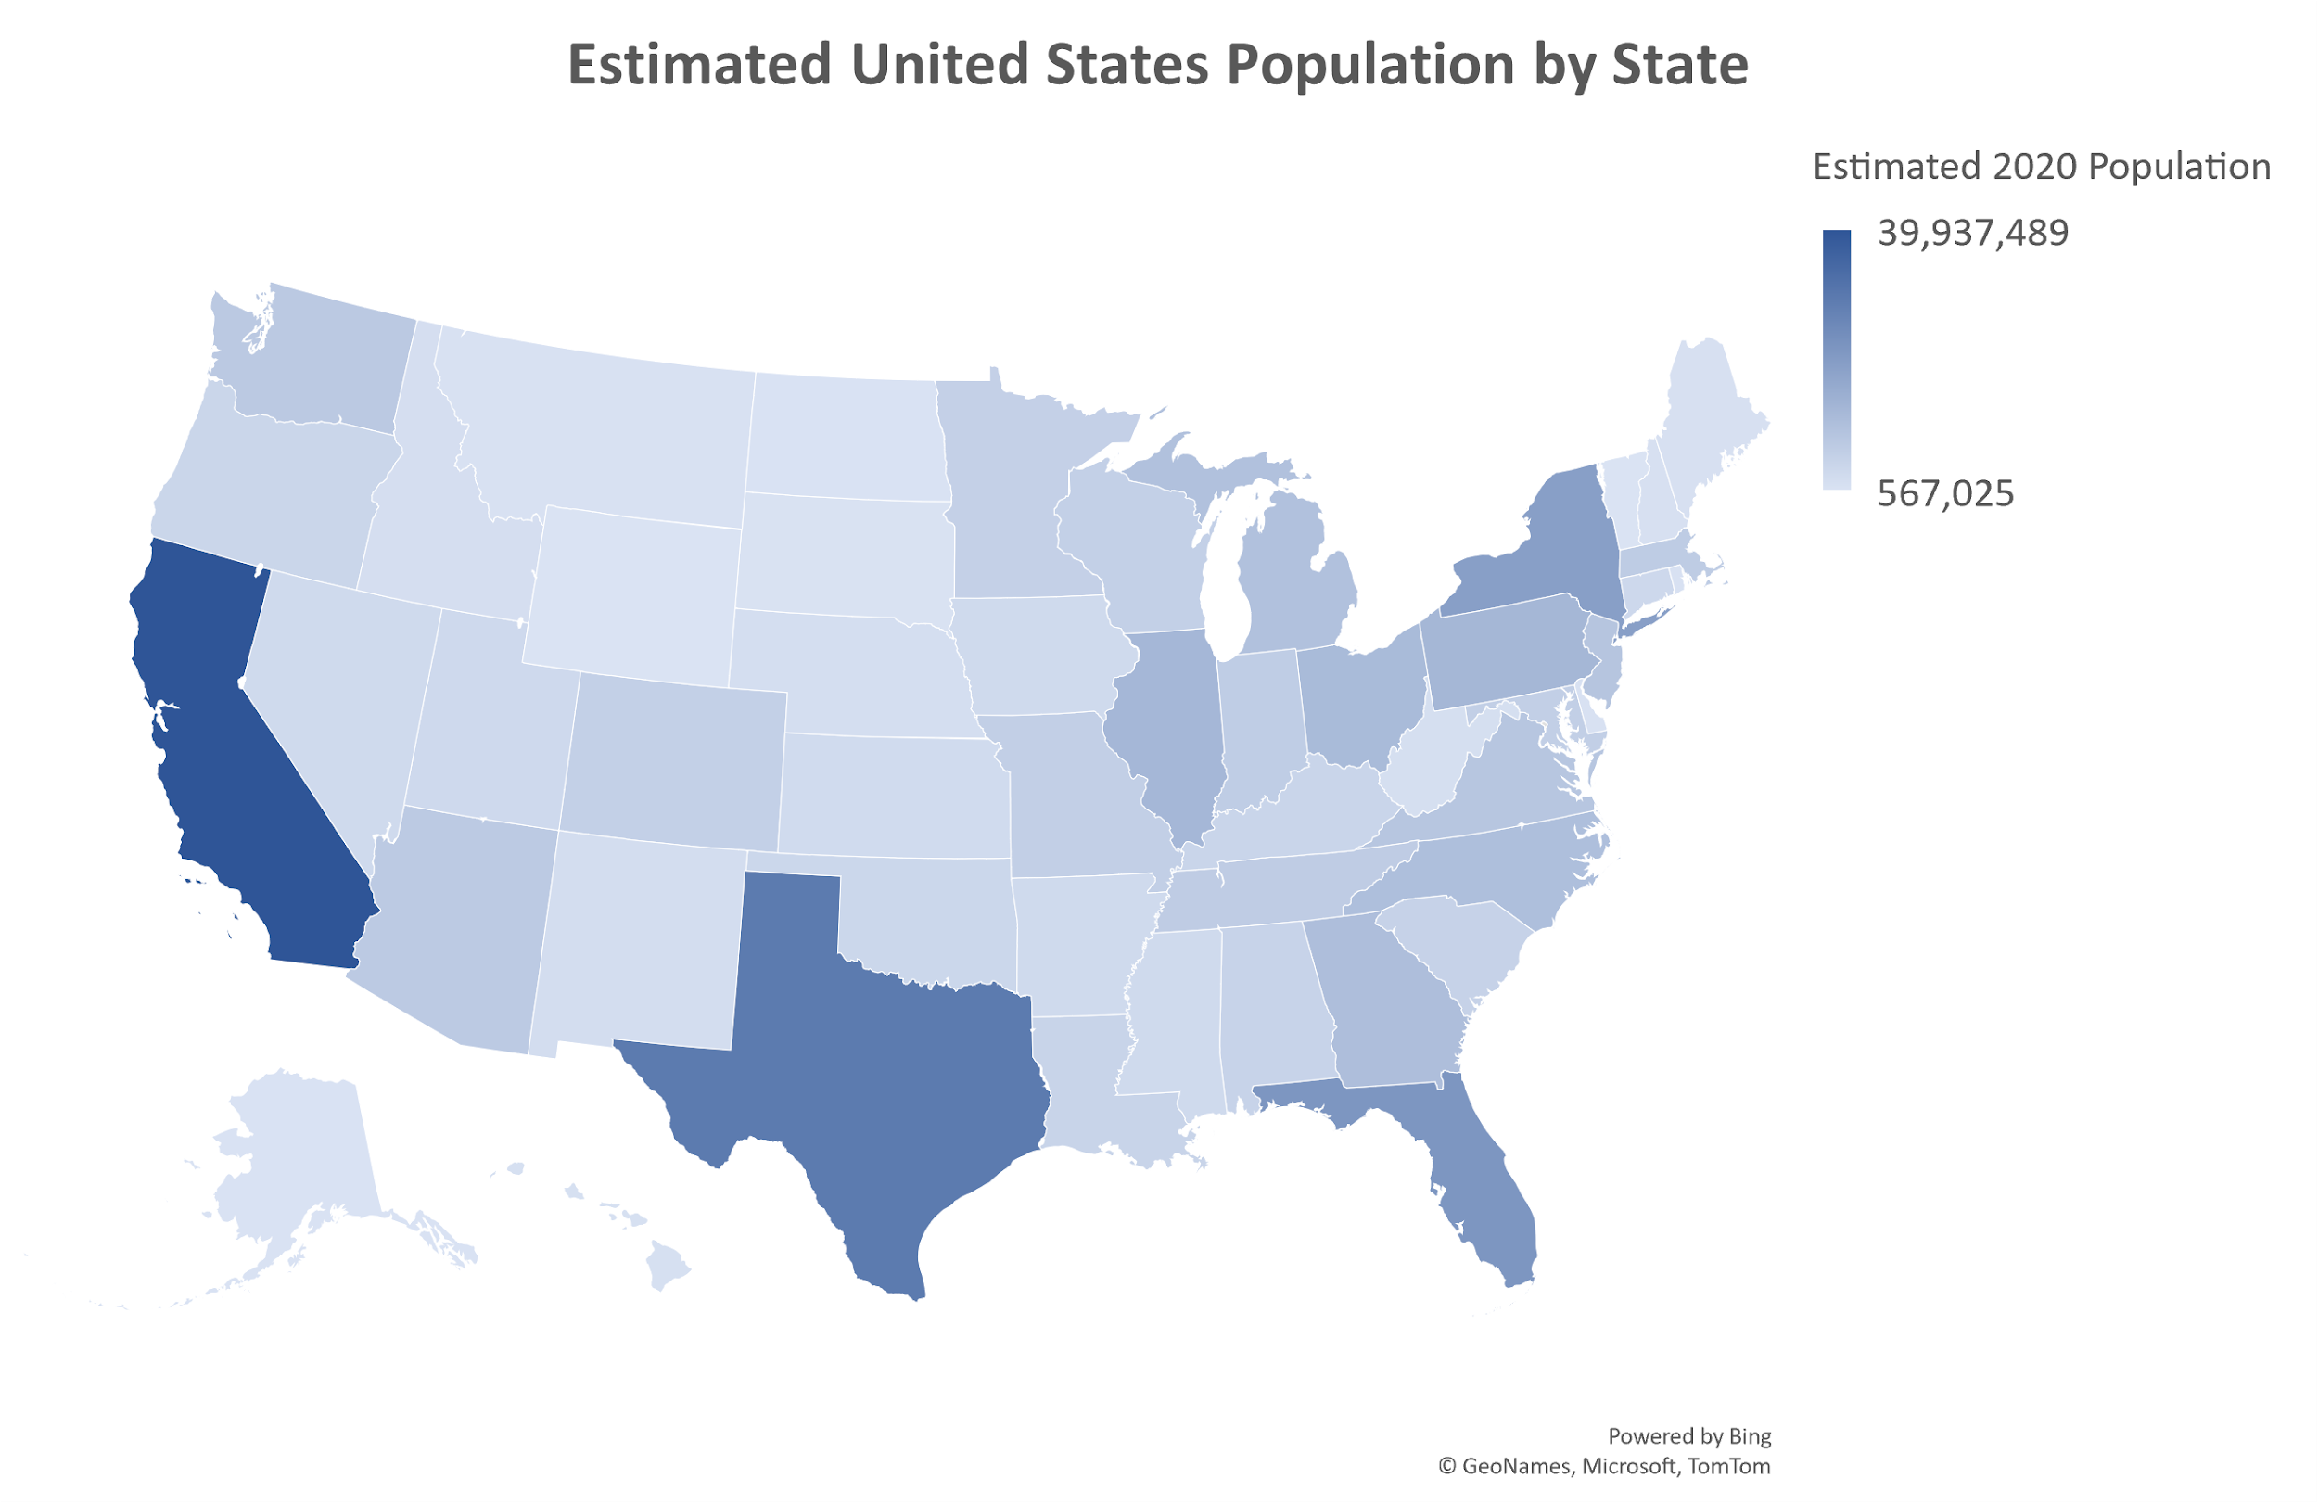
2.5 Choropleth Maps
Choropleth maps can be built for quantitative or categorical data.
Color shading is used to denote the population of each state, a quantitative variable.
A darker shade will indicate a higher population and a lighter shade a lower population.
The map shows that the states with the highest population are California, Texas, Florida, and New York.
We can also build choropleth map for categorical data.

Slide 22
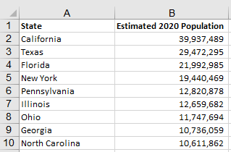
2.5 Build a Choropleth Map
A choropleth map is a geographic map that uses colors or symbols to indicate aggregate measures or statistics by geographic region.
The following steps show how to create a choropleth map in Excel using the data in the file StatePopulation.
Step 1. Select cells A1:B51
Step 2. Click the Insert tab on the Ribbon
Step 3. In the Charts group, click the Maps button
Step 4. Select Filled Map
Then edit the chart as outlined in Section 2.2.

Slide 23
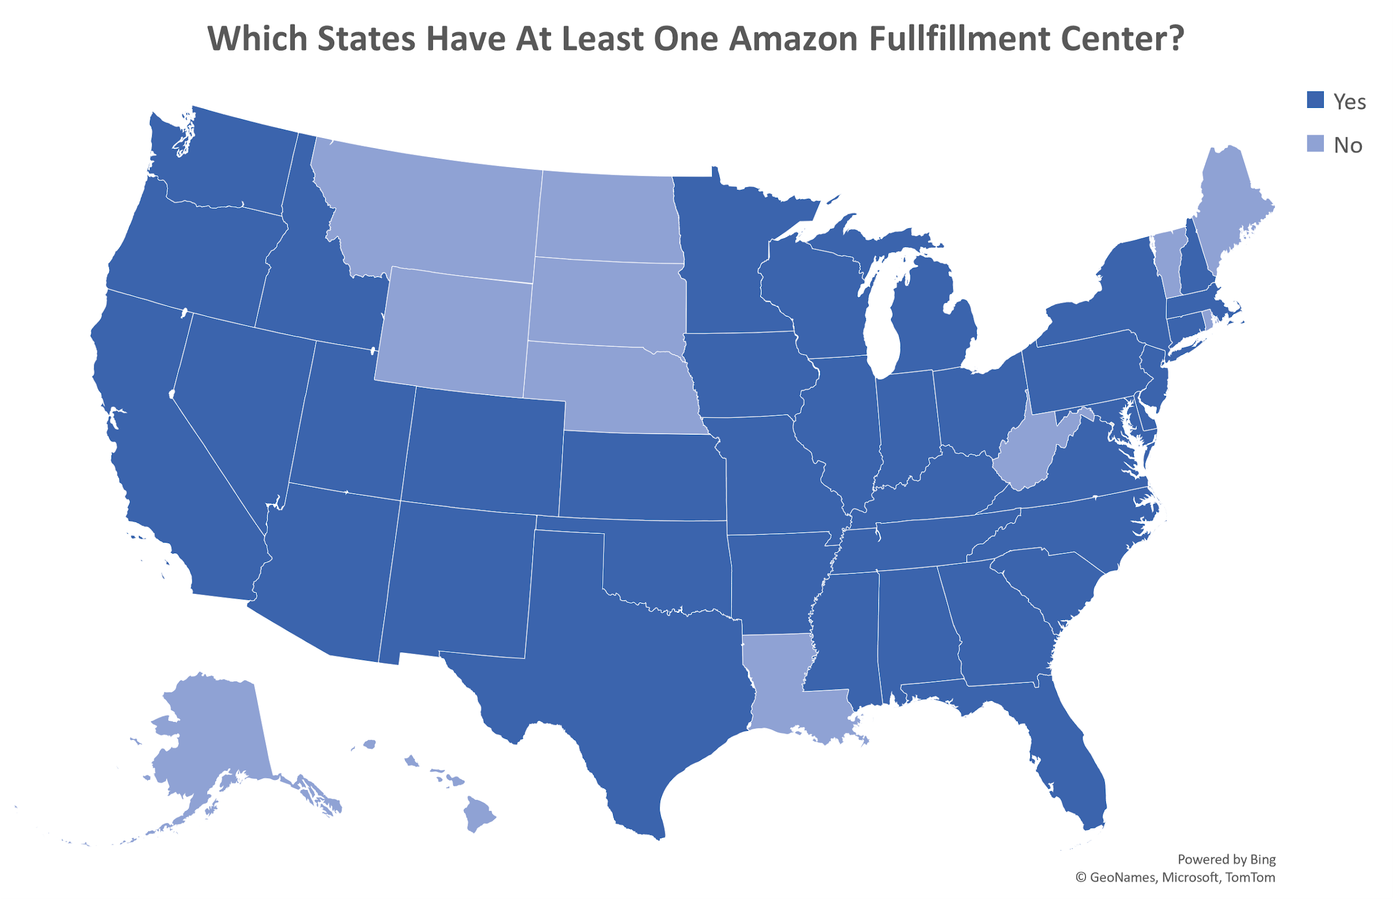
2.5 Choropleth Maps for Categorical Data
This choropleth map was created in Excel using categorical data from the file AmazonFulfill and following the steps used in the previous example.
The map shows that Amazon has at least one fulfillment center in 38 states.
States without a fulfillment center tend to be either relatively sparsely populated or a geographic outlier.
Amazon has many fulfillment centers to ensure quick customer delivery times for many of the products it sells.

Slide 24
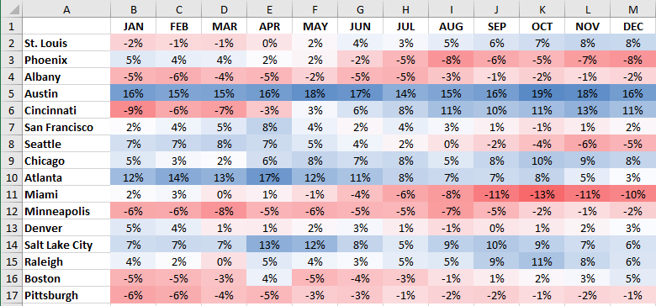
2.5 Heat Maps
A heat map is a 2D graphical representation of a data table that uses shades of color to indicate magnitude.
The following steps show how to create a heat map in Excel using the data in the file SameStoreSales.
Step 1. Select cells B2:M17
Step 2. Click the Home tab on the Ribbon
Step 3. Click Conditional Formatting in the Styles group, select Color Scales, and click on Blue-White-Red Color Scale

Slide 25
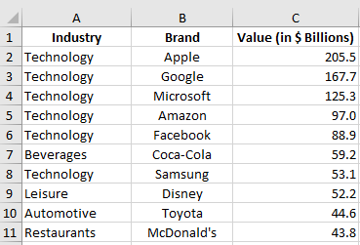
2.5 Build a Treemap
The following steps show how to create a treemap in Excel using the data in the file BrandValues.
Step 1. Select cells A1:C11
Step 2. Sort the data by Industry by using the following steps:
Click Data on the Ribbon
Click the Sort button in the Sort & Filter group
In the Sort dialog box, select Industry from the drop-down menu
From the Order drop-down menu select A to Z
Step 3. Click Insert on the Ribbon
Step 4. Click on the Insert Hierarchy Chart button in the Charts group and select Treemap from the drop-down menu

Slide 26
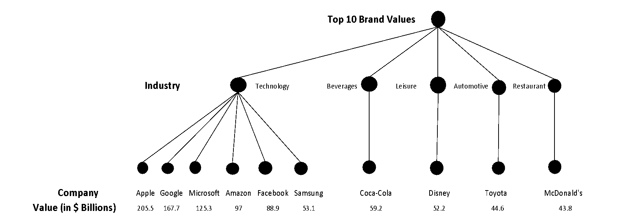
2.5 Hierarchy of a Treemap
The Hierarchical Tree Structure of the Top Ten Brand Values Data

Slide 27
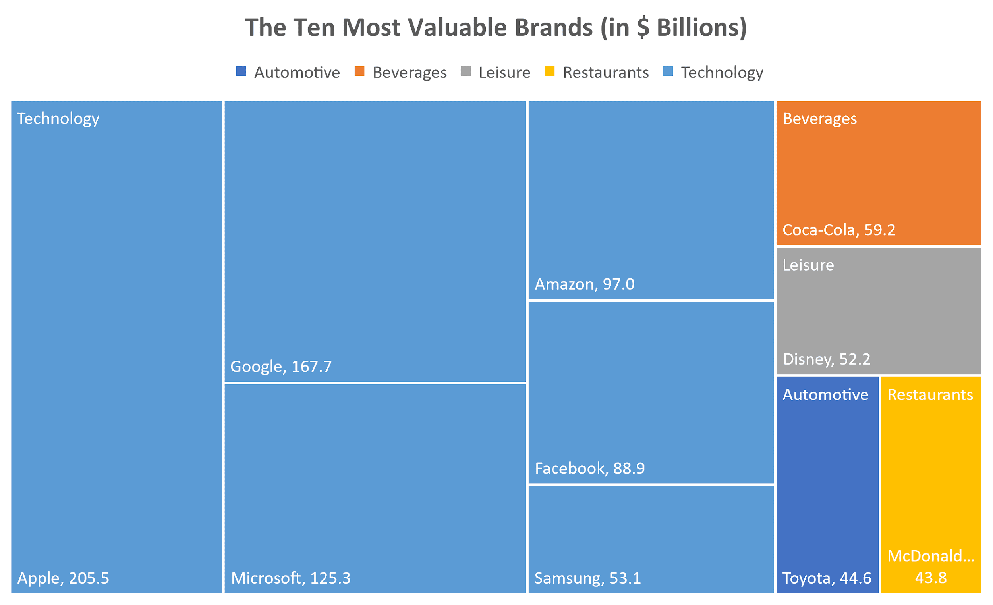
2.5 Edit a Treemap
A treemap is a chart that uses the size, color, and arrangement of rectangles to display the magnitudes of a quantitative variable for hierarchical data.
To display the brand values:
Step 5. Select any brand label and then right-click
Step 6. Select Format Data Labels… from the drop-down menu
Step 7. Select Text Options, Label Options, and select Value

Slide 28
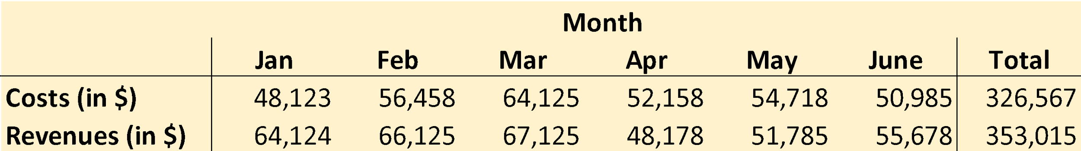
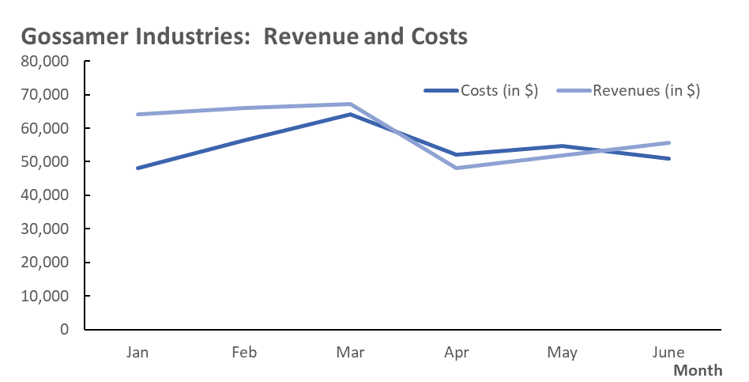
2.6 Tables versus Charts
Table Showing Exact Values for Costs and Revenues by Month for Gossamer Industries
Tables should be used when:
The reader needs to refer to specific numerical values
The reader needs to make precise comparisons between different values and not just relative comparisons
The values being displayed have different units or very different magnitudes
Line Chart of Monthly Costs and Revenues

Slide 29
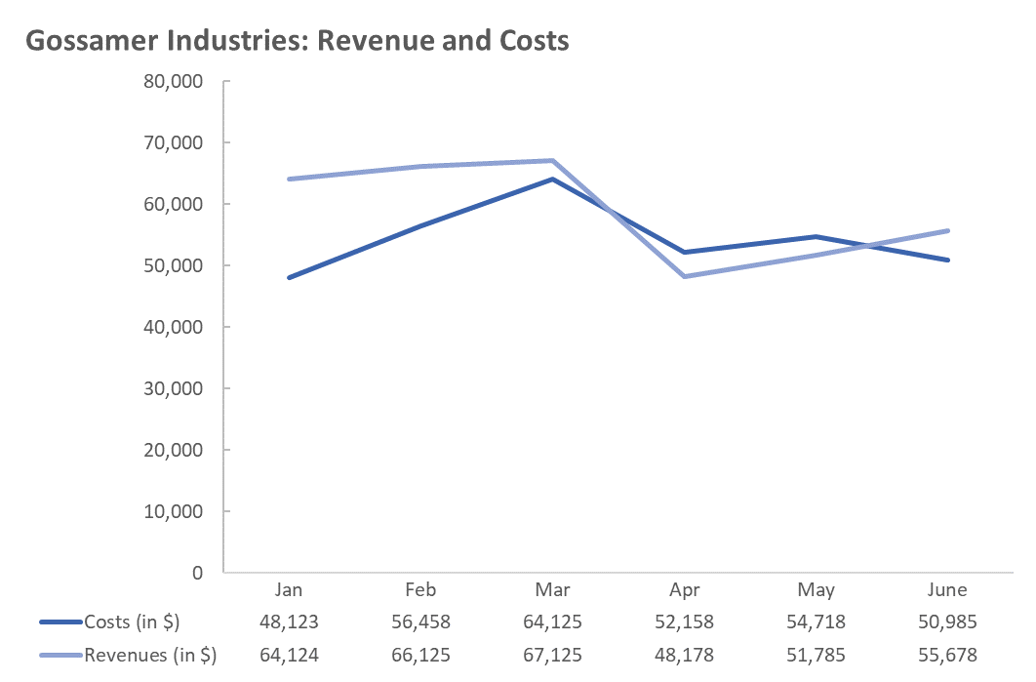
2.6 Combined Line Charts and Tables
The following steps show how to create a combined line chart and table in Excel using the data in the file Gossamer.
Step 1. Select cells A2:G4
Step 2. Click the Insert tab on the Ribbon
Step 3. Click the Insert Line or Area Chart button in the Charts group
Step 4. When the list of column and bar charts subtypes appears, click the Line button
Step 5. Click anywhere on the chart
Click the Chart Elements button
Select the check box for Data Table, and edit the chart as outlined in Section 2.2.

Slide 30
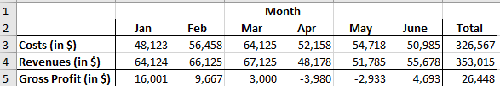
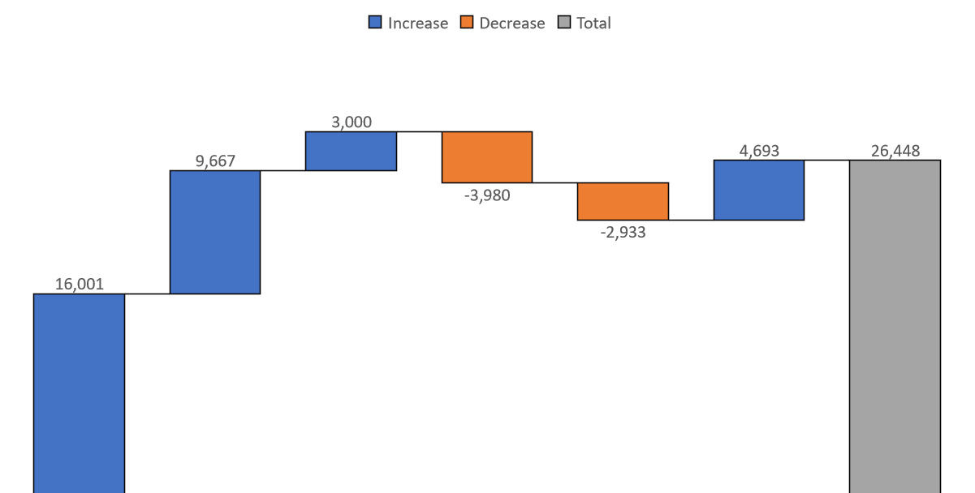
2.7 Waterfall Charts
GossamerGP data file for Gossamer costs, revenues, and gross profit
A waterfall chart for the gossamer gross profit data
*See the notes for step-by-step instructions on how to build a waterfall chart.
Notes:
The following steps were used to create the waterfall chart for the Gossamer gross profit data.
Step 1. Select cells A2:H2. Hold down the control key (Ctrl) and also select cells A5:H5
Step 2. Click the Insert tab on the Ribbon
Step 3. Click the Insert Waterfall, Funnel, Stock, Surface or Radar Chart button in the Charts group
Step 4. When the list of subtypes appears, click the Waterfall button
In the initial chart, notice that the Total has been treated like another month. The following steps will make the total appear as in the waterfall shown for the Gossamer Gross Profit data.
Step 5. Double click on the column Total to activate the Format Data Series task pane
Step 6. Click the column of data again to activate the Format Data Point task pane
Step 7. When the Format Data Point task pane appears, click on the Series Options button
Step 8. Select Set as total
Then edit the chart as outlined in Section 2.2.

Slide 31
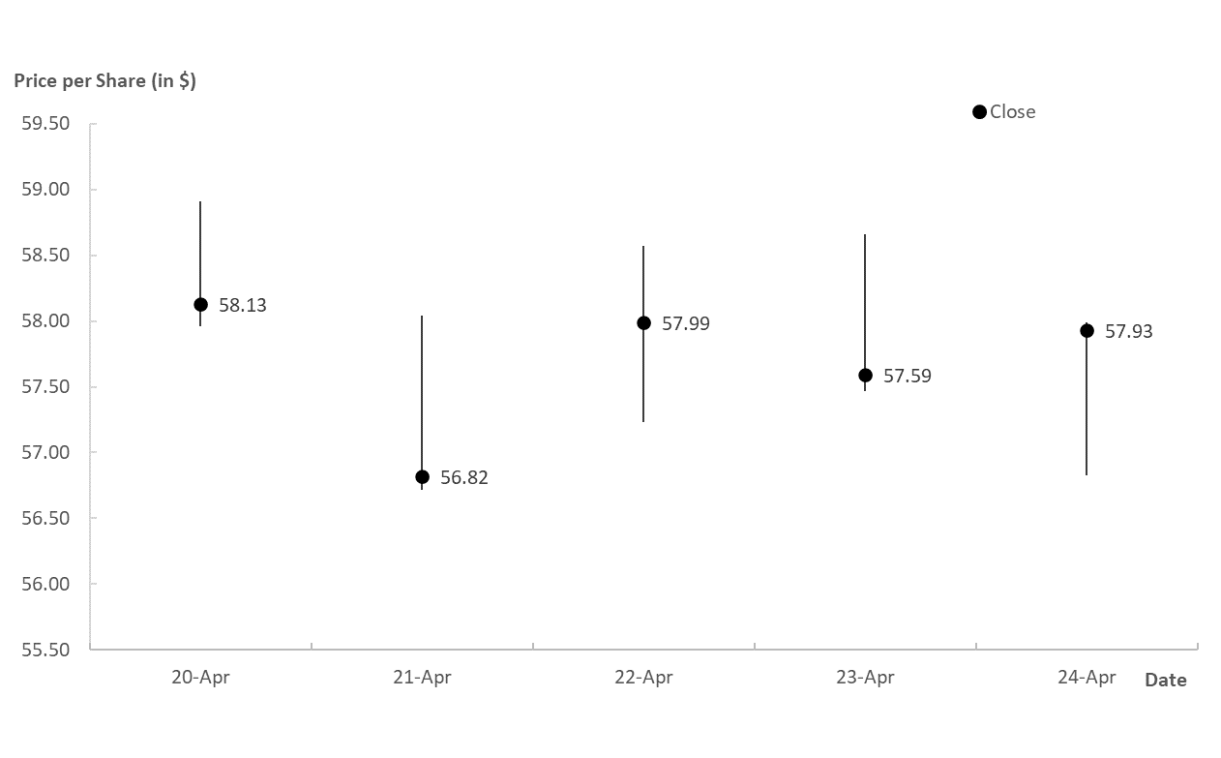
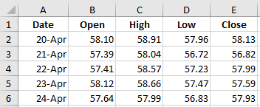
2.7 Stock Charts
Verizon stock price data file
A high-low-close stock chart for Verizon Wireless
*See the notes for step-by-step instructions on how to build a high-low-close stock chart.
Notes:
The following steps were used to create a high-low-close stock chart for the Verizon Wireless data.
Step 1. Select cells A1:A6. Hold down the control key (Ctrl) and select cells C1:E6
Step 2. Click the Insert tab on the Ribbon
Step 3. Click the Insert Waterfall, Funnel, Stock, Surface or Radar Chart button in the Charts group
Step 4. When the list of subtypes appears, click the High-Low-Close button
Edit the chart using steps outlined in Section 2.2.
The following steps add the closing price labels and markers.
Step 5. Click on the Chart Elements button and select Data Labels.
Step 5 places three sets of labels on each vertical bar (highest, closing and lowest price per share). The following steps clean up the display.
Step 6. Click on any of the high price per share labels and press the delete key. Do the same for the low price per share labels.
Step 7. On one of the vertical lines, click on a data point directly next to one of the closing price labels.
Step 8. When the Format Data Series task pane appears, click the Fill &Line button, then click on Marker. Under Fill, select Solid fill and to the right of Color, select black from the drop-down menu. Under Border, select Solid line, and to the right of Color, select black from the drop-down menu. To the right of Width, select 3 pt.

Slide 32
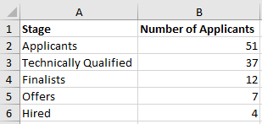
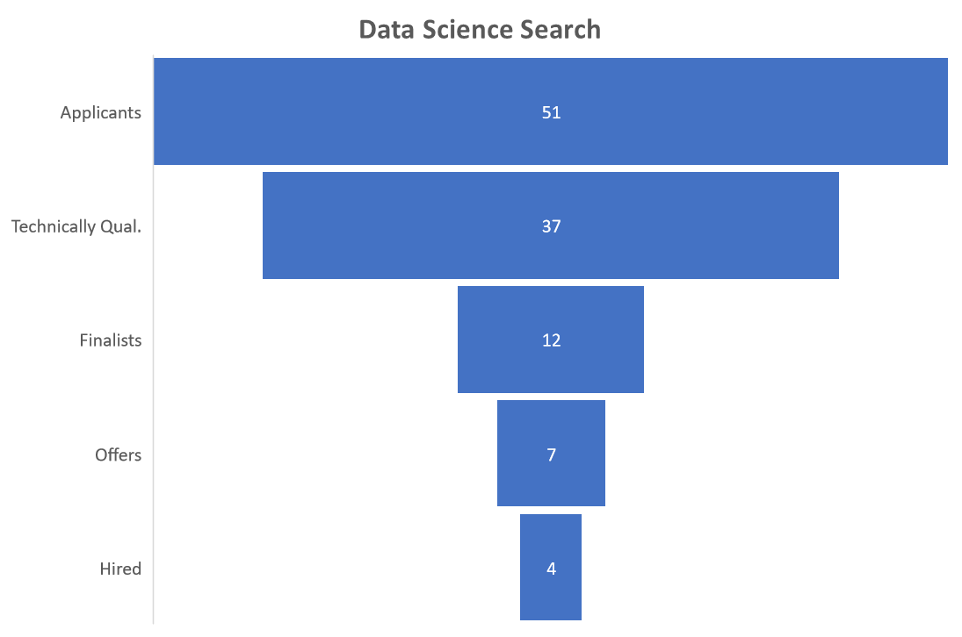
2.7 Funnel Charts
DataScienceSearch data for hiring
A funnel chart for Data Scientist hiring
The following steps may be used to create the funnel chart shown for Data Scientist hiring:
Step 1. Select cells A1:B6.
Step 2. Click the Insert tab on the Ribbon
Step 3. Click the Insert Waterfall, Funnel, Stock, Surface or Radar Chart button in the Charts group
Step 4. When the list of subtypes appears, click the Funnel Chart button
Then edit the chart using steps outlined in Section 2.2.

Slide 33

2.8 Guidelines for Selecting a Chart
Chart | Relationship | Distribution | Composition | Ranking
Scatter
Bubble
Line
Stock
Column
Bar
Heat Map
Choropleth Map
Stacked Bar
Stacked Column
Treemap
Waterfall
Funnel

Slide 34
2.8 Charts to Avoid
Here is a summary of some types of charts data visualization experts agree should be avoided:
To visualize the contribution of each category to a whole entity, use a pie chart in which the slices represent each category contribution.
When there are more than a few categories, pie charts tend to be cluttered and hard to interpret. Consider us a bar chart instead.
Science has shown that we are better at determining differences in length than angle and area. The bar chart makes it much easier to tell which category has the larger allocation.
Color should only be used to distinguish between categories when necessary. For the bar chart, color is not needed, as the length of the bars is used to quantify allocation by category.
In a horizontal bar chart, the category labels, a few of which are rather lengthy, are easier to read.
Avoid combo charts and 3D representations of a 2D chart.

Slide 35
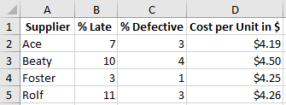
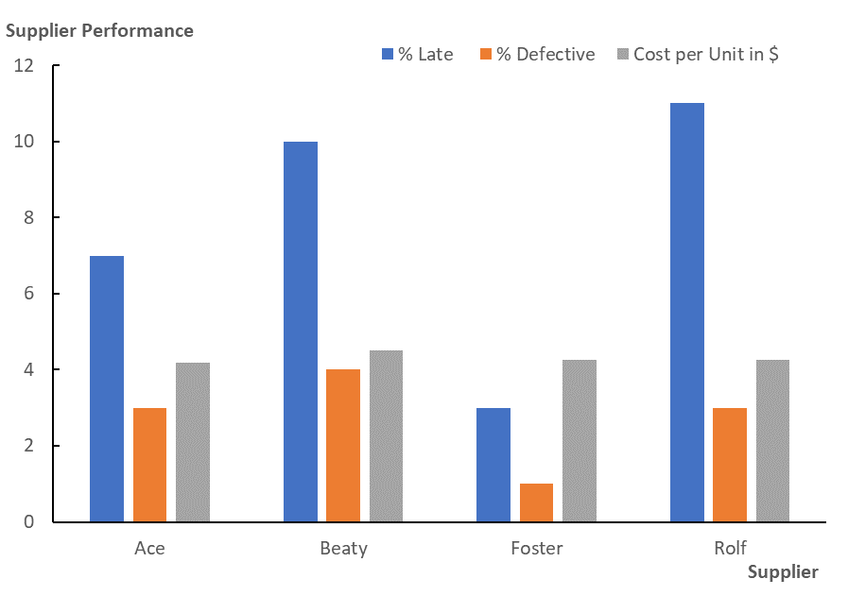
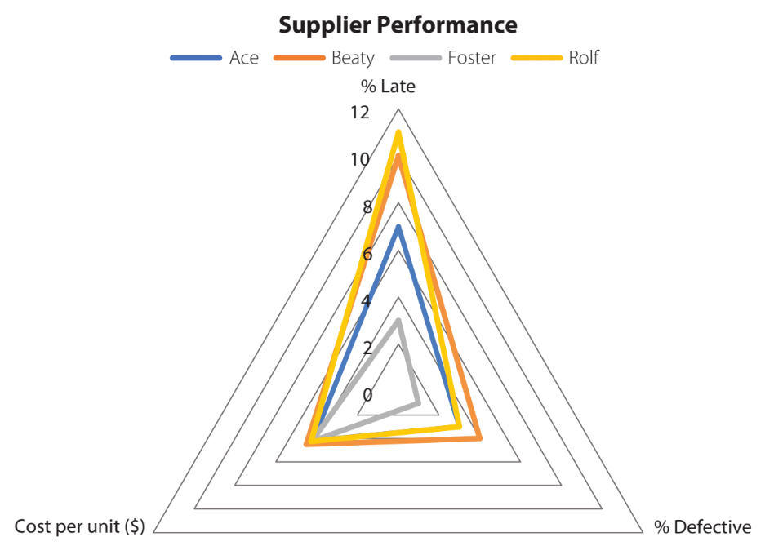
2.8 Charts to Avoid – Radar Chart
NewtonSupplier data file for a component performance
Better choice: a clustered column chart of supplier performance for a component for Newton Industries
A radar chart of supplier performance for a component for Newton Industries

Slide 36
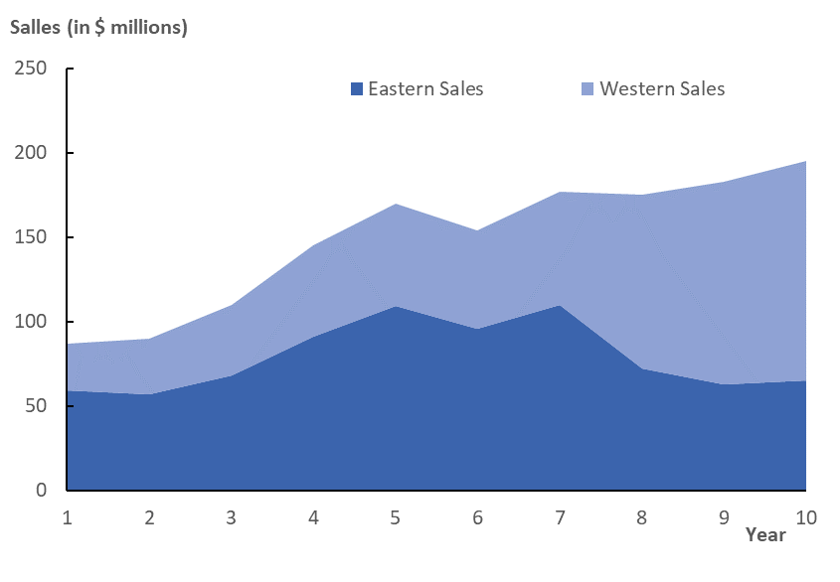
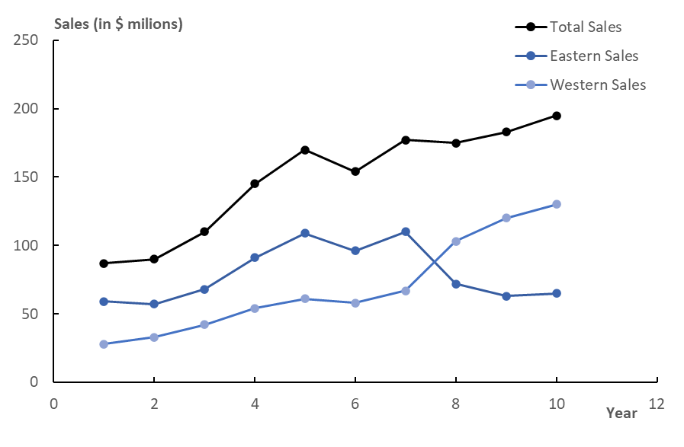
2.8 Charts to Avoid – Area Chart
An area chart for the Cheetah Sports regional sales data
Better choice: a multiple line chart for the Cheetah Sports regional sales data

Slide 37
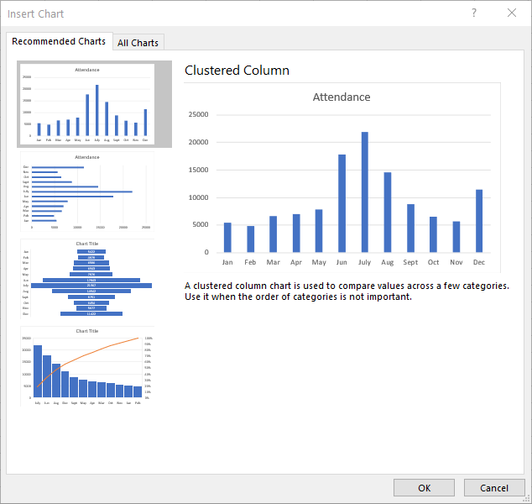
2.8 Excel’s Recommended Charts Tool
The Insert Chart task pane for the Zoo Attendance data
The following steps show how to use the Recommended Charts tool using data in the file Zoo.
Step 1. Select cells A1:B13
Step 2. Click the Insert tab on the Ribbon
Step 3. Click the Recommended Charts button in the Charts group
Step 4. When the Insert Chart task pane appears, select any of the four Recommended Charts to the left.
Step 5. Select the Clustered Colum chart and click OK.
Then edit the chart as outlined in slide 6.
*See additional instructions in the notes.
Notes:
After clicking the Recommended Charts button, observe that selecting the All Charts tab from the Insert Chart task pane generates a listing of all available chart types. Selecting any of the listed charts provides a preview of the selected chart.
Hence an alternative to navigating the Charts group on the Insert tab is to click the Recommended Charts button, select the All Charts tab and select from the list.
The Recommended Charts tool does not always recommend chart types consistent with the advice in this chapter.

Slide 38
Check Your Knowledge
Which of these is an appropriate alternative to a radar chart?
Choropleth
3D bubble chart
Treemap
Clustered column chart
To achieve the colored and shading effect for a heat map in Excel, use the options in the _______ menu.
Format Data Labels
Chart Options
Conditional Formatting
Insert Chart

Slide 39
Summary
In this chapter, you should have learned how to:
Select a suitable chart, given the goals of the analysis and the type of data.
Create and edit through step-by-step instructions the following charts in Excel:
Relationship charts, such as the scatter chart, bubble chart, and line chart.
Composition charts, such as clustered/stacked column and bar charts.
Maps, such as choropleth geographical maps, heat maps, and treemaps.
Specialized charts, such as waterfall, stock, and funnel charts.
Charts to avoid, such as radar and area charts.

